Slide 1
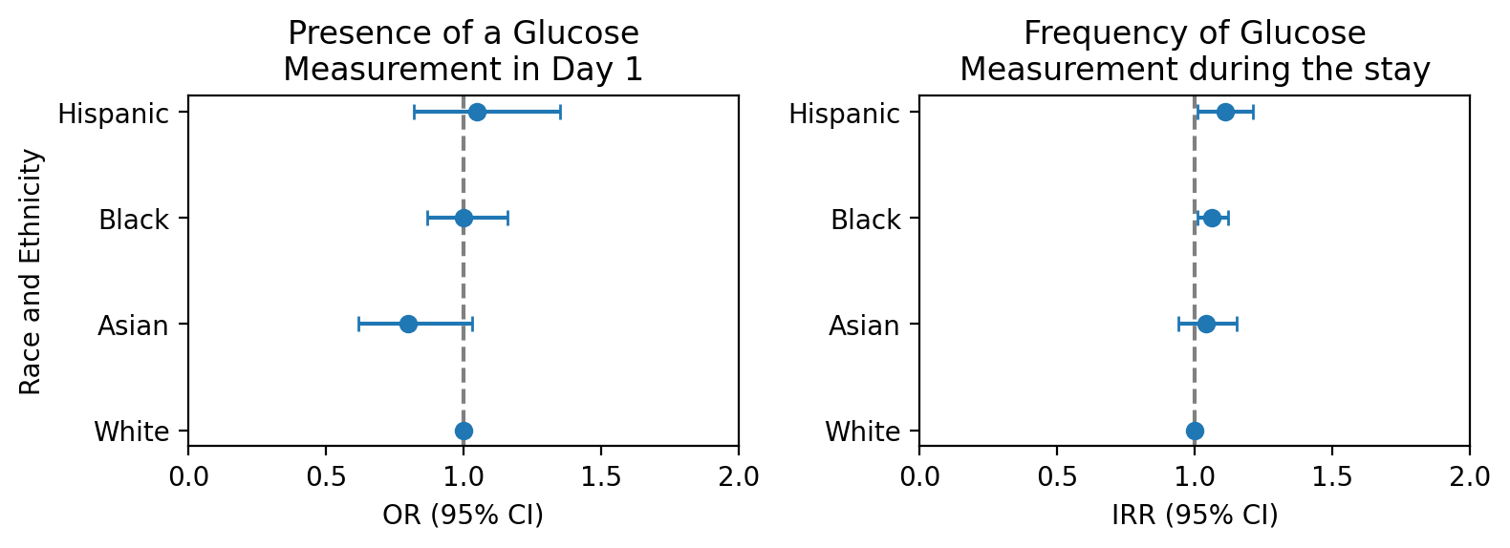
Variation in monitoring: Glucose in the ICU as a case study for identification of potential spurious correlations
Setting & Participants
Results & Conclusion
Medical Information Mart for Intensive Care Database
Tertiary Care Hospital
in Boston (USA)
Population 24,927 ICU sepsis stays
with known race and ethnicity in MIMIC-IV
Conclusion Disparities in ICU glucose measurements exist and could potentially lead to bias in subsequent AI algorithms by engraining spurious correlations.

